Slide 1
Planning and Decision-Making (Chapters 4&17)
Dr. Shengquan Wang
Most slides are adopted from
Artificial Intelligence: A Modern Approach, 4th ed. by Stuart Russell (UC Berkeley) and Peter Norvig (Google).
Peter Norvig and Sebastian Thrun for Intro to Artificial Intelligence at Udacity.
Sutton, Richard S., and Andrew G. Barto. Reinforcement learning: An introduction.

Slide 2
Review: Logic and Bayesian Networks
Both are model-based for knowledge representation and focus on inference
Propositional logic: Boolean
First-order logic: relational
Bayesian Networks: uncertainty
They don’t address how to achieve a certain goal.
Planning agents: how to achieve a certain goal.

Slide 3
A Simple Planning Agent: Problem Solving with A* Search
291+380=671
75+374=449
140+253=393
239+176=415
176
220+193=413
118+329=447
317+100=417
450
100
418
366+160=526

Slide 4

Execution in Practice: Uncertainty
The environment is very complex.
Roads are not straight, not flat.
Maybe due to road closure, a detour is needed.
The sensors of the agent come with some measurement errors.
Even GPS’s error range is 10m.
The outcome of executing the plan could be different from your expectation.
B
A

Slide 5
Plan with Uncertainty
In the environments with uncertainty, the solution to a problem is no longer a sequence of actions, but rather a conditional plan (or a contingency plan or a strategy).
A contingency plan specifies what to do depending on what percepts agent receives while executing the plan.

Slide 6
Outline
Conditional Plan

Slide 7
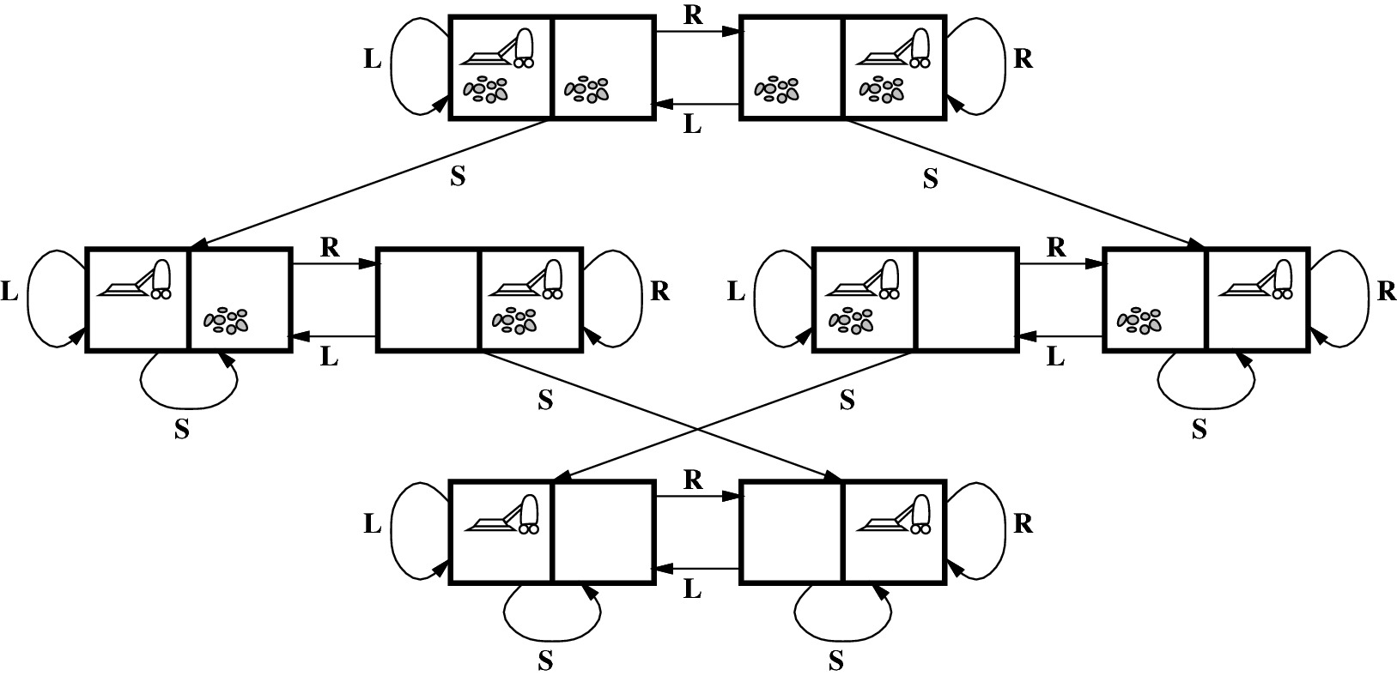
State Space of Vacuum Cleaner
What if the sensor is not working?

Slide 8
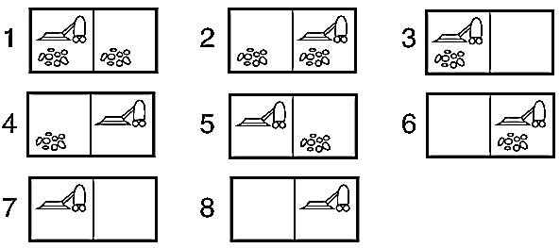
Sensorless
Initial belief states
Sensorless: Vacuum cleaner doesn’t know which state it is. But it can still suck and move and know if there is a wall when hitting a wall.

Slide 9
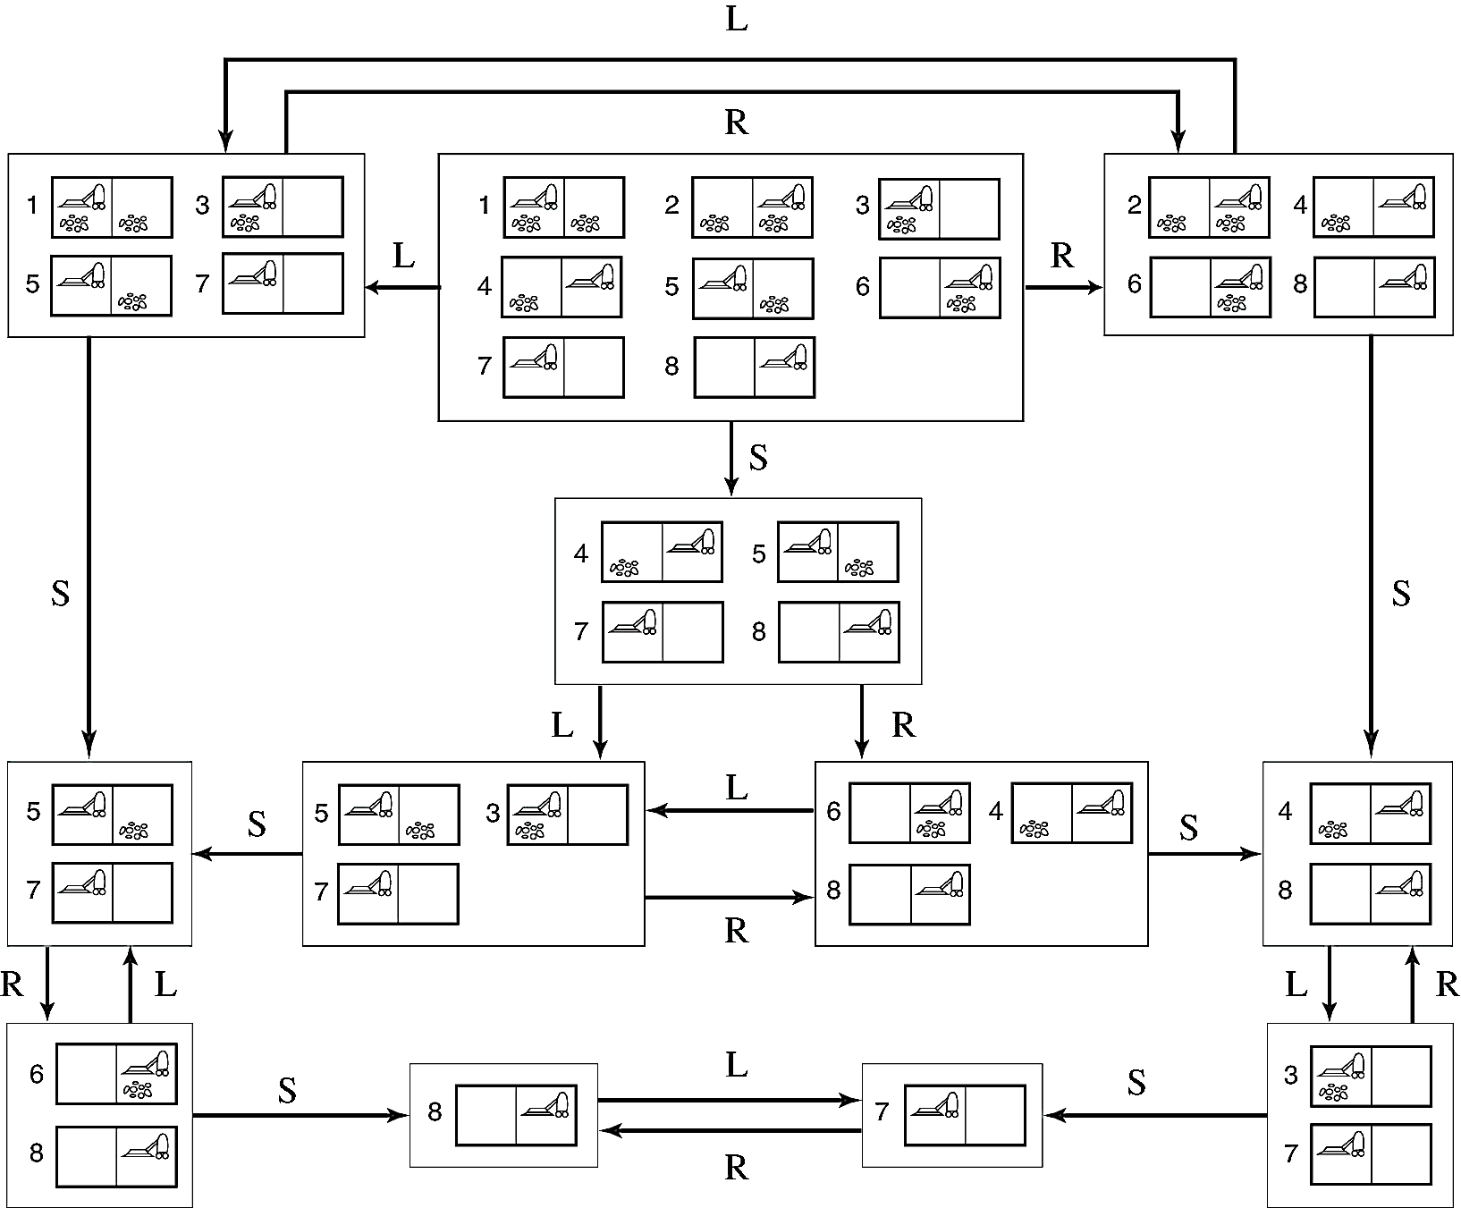
Transition Model
Notes:
In this model, suck and move are deterministic (we are not considering they have error and assuming they function with 100% accuracy/no errors).

Slide 10

Quiz: Planning
Initial state: its square is clean
Goal state: all squares are clean

Slide 11
Solution

Slide 12
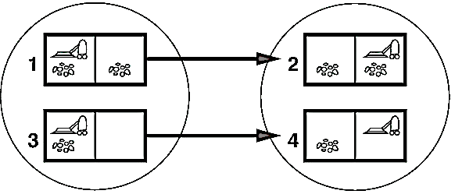
Local-Sensing
Initial state
A
B
R
Local sensing: only know its position and if its square has dirt or not, not the other square.
Notes:
In this example, initial state (A) robot knows its spot its dirty and its position; so there are two possible starting states as shown (1 or 3), and moving right will result in 2 other possible states of the entire model (2 or 4).

Slide 13
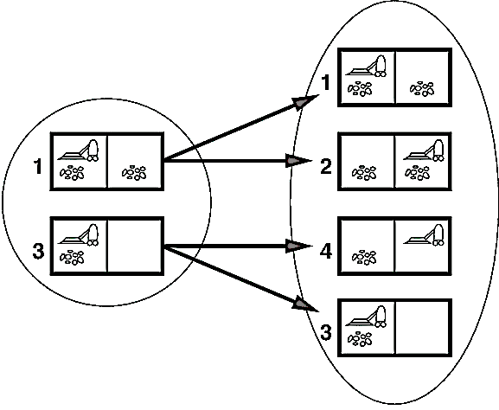
Local-Sensing plus Slippery-Wheel
Initial state
A
B
R
Slippery wheel: moving or staying

Slide 14
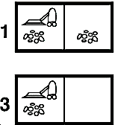
Quiz: Planning
Initial state: its square is dirty
Goal state: all squares are clean
A
B
Plan (sequence of actions) | Goal achievable (Always/Maybe)
[S, R, S]
[R, S, L, S]
[S, R, R, S]
[S, R, S, R, S]
Maybe
Maybe
Maybe
Local-Sensing plus Slippery-Wheel
Maybe
Notes:
1 and 3 are showing the 2 possible initial state when robot knows its location and if it is dirty.
In this example, we have slippery wheel so that moving has some error (probability robot does not move to its correct location).
Thus, no matter what, there is always some probability (even if very small) that the system does not reach goal state due to possible infinite sequence of never being able to move to another location.

Slide 15
Infinite Sequence
A
B
S
R
B
S
A
[S, while A: R, S]

Slide 16
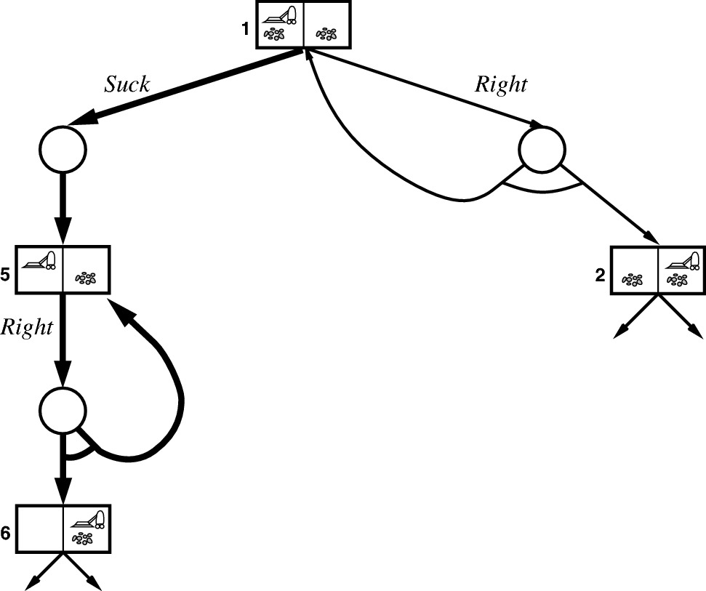
Search Tree for Finding a Successful Plan

Slide 17
Next
So far we learned how to build a conditional plan for a simple example such as vacuum cleaner.
What about more complex planning problems?
It is hard to come up with a conditional plan for a general case.
Instead, we focus on a simplified complex model called Markov Decision Process (MDP).
Markovian assumption can simplify study a lot as we did for Bayesian networks over time.
Notes:
Remember Markov assumption: the next state only depends on the prior (not two or more previous states ago).

Slide 18
Outline
Conditional Plan
Markov Decision Process (MDP)

Slide 19
Markov Decision Process (MDP)
MDP: a sequential decision problem for a fully observable, stochastic environment with a Markovian transition model and additive rewards.
A set of states {s} including an initial state;
A set of actions {a} in each state;
A Markovian transition model P(s’|s, a);
An additive reward function R(s,a,s’);
Sequential decision: what action should we choose in each state along the sequence?

Slide 20

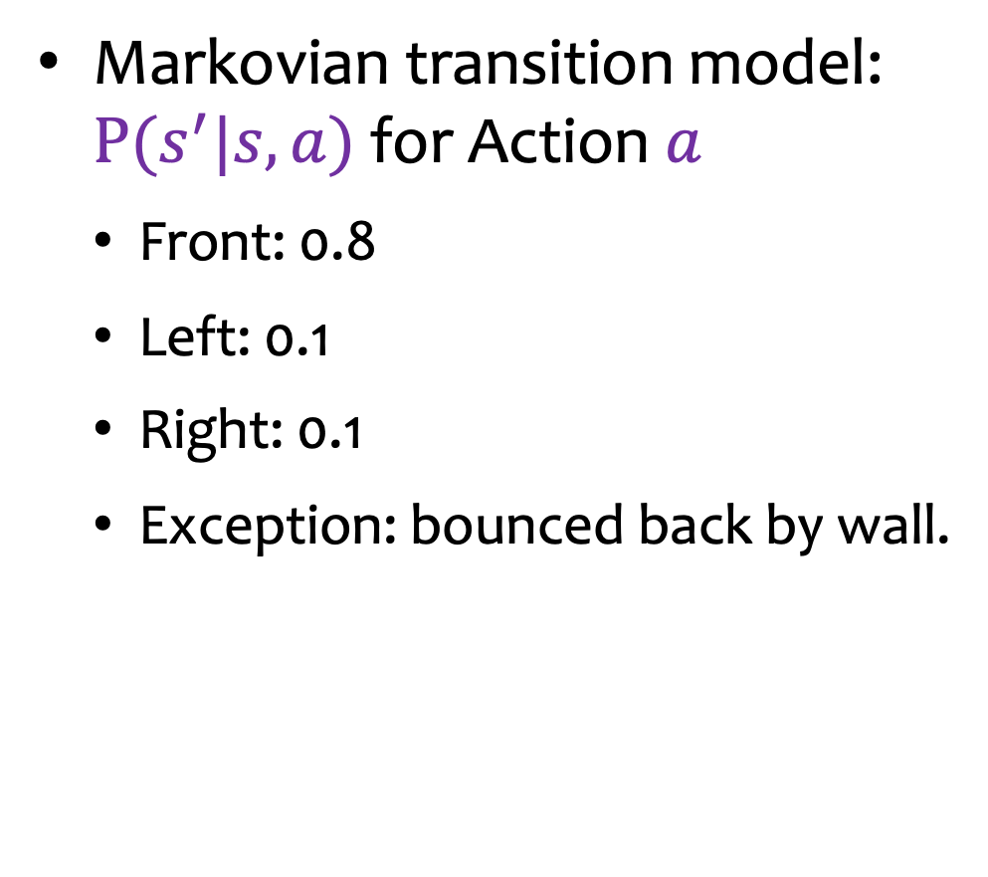
MDP in a Grid World: Transition Model
Markovian transition model: $P(s^{′}|s,a)$for Action $a$
Front: 0.8
Left: 0.1
Right: 0.1
Exception: bounced back by wall.
c
b
a
1
2
3
4
0.8
0.1
↑
0.1
0.1
↑
0.8
0.1

Slide 21
MDP in a Grid World: Example of Actions
c
b
80%
↑
c
a
10%
10%
1
2
3
4
b
80%
↑
a
10%
10%
c
1
2
3
4
b
↑
a
10%
80%
10%
1
2
3
4

Slide 22
MDP in a Grid World: Reward Function
Reward function: R(s,a,s’)
Example 1:
Absorbing state: +100, -100
Others: 0
Example 2:
Absorbing state: +100, -100
Others: -1
The above reward is independent of a and s’, i.e., R(s,a,s’)=R(s).
0 | 0 | 0 | +100
0 |  | 0 | -100
0 | 0 | 0 | 0
c
b
a
1
2
3
4
-1 | -1 | -1 | +100
-1 |  | -1 | -100
-1 | -1 | -1 | -1
c
b
a
1
2
3
4
Notes:
Absorbing state: when you get there, you are trapped; we want to of course be trapped at +100 goal state.

Slide 23
Policy
-1 | -1 | -1 | +100
-1 |  | -1 | -100
-1 | -1 | -1 | -1
c
Policy π: π(s) is the action recommended by the policy π for each state s.
Actions at each state in Grid World: ← ↑ → ↓
Planning: to find an optimal policy.
What is the action recommended by an optimal policy at State a1?
To determine if a policy is good or not, we can apply Utility Theory.
b
a
1
2
3
4

Slide 24
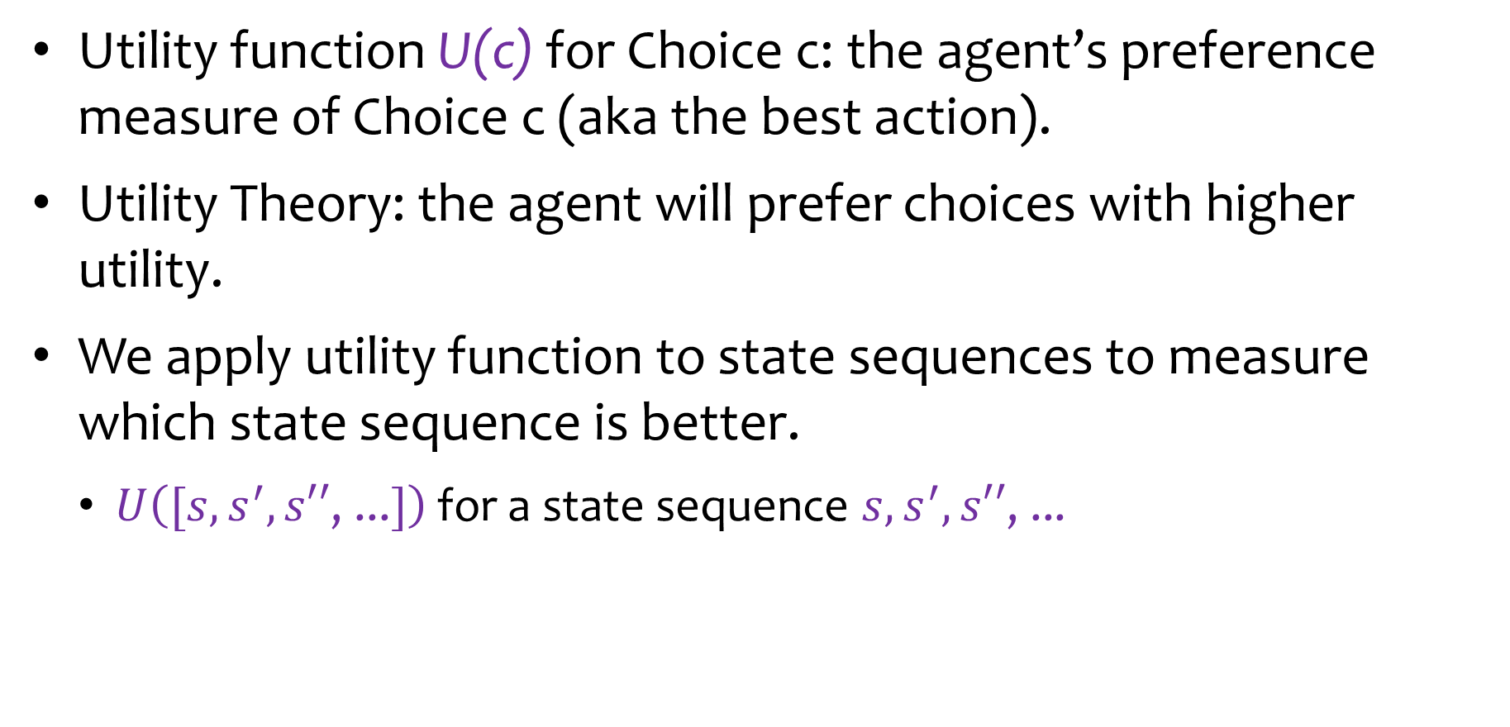
Utility Theory
Utility function U(c) for Choice c: the agent’s preference measure of Choice c (aka the best action).
Utility Theory: the agent will prefer choices with higher utility.
We apply utility function to state sequences to measure which state sequence is better.
$U\left([s,s^{′},s′′\text{, ...}]\right)$ for a state sequence $s,s^{′},s′′\text{, ...}$

Slide 25
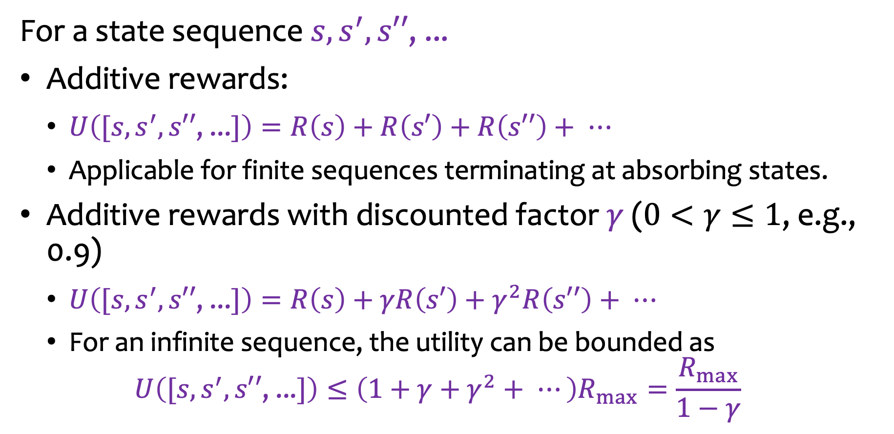
Utility Function of a State Sequence
For a state sequence $s,s^{′},s′′\text{, ...}$
Additive rewards:
$U\left([s,s^{′},s′′\text{, ...}]\right)=R\left(s\right)+R\left(s′\right)+R\left(s′′\right)+ ⋯$
Applicable for finite sequences terminating at absorbing states.
Additive rewards with discounted factor $γ$ ($0<γ≤1$, e.g., 0.9)
$U\left([s,s^{′},s′′\text{, ...}]\right)=R\left(s\right)+γR\left(s′\right)+γ^{2}R\left(s′′\right)+ ⋯$
For an infinite sequence, the utility can be bounded as $U\left([s,s^{′},s′′\text{, ...}]\right)≤\left(1+γ+γ^{2}+ ⋯\right)R_{max}=\frac{R_{max}}{1−γ}$

Slide 26
Why Discounted Reward?
Avoid infinite utility in MDP with cycles.
Discourage a long sequence.
If the reward is financial, immediate rewards may earn more interest than delayed rewards.
Animal/human behavior shows preference for immediate reward.

Slide 27

Example in a Grid World
$$γ=0.9$$
Reward
Sequence: a1, b1, c1, c2, c3, c4.
U[a1, b1, c1, c2, c3, c4] = (-1) + 0.9(-1) + 0.9²(-1) + 0.9³(-1) + 0.9⁴(-1) + 0.9⁵(100) = 54.95
-1 | -1 | -1 | +100
-1 |  | -1 | -100
-1 | -1 | -1 | -1
c
b
a
1
2
3
4
Notes:
Note on notation above:
U[a1, b1, c1, c2, c3, c4] = (-1) → refers to the reward at each of the states in the brackets is -1; thus calculate the Utility of that state sequence while also considering the discount factor of 0.9.

Slide 28
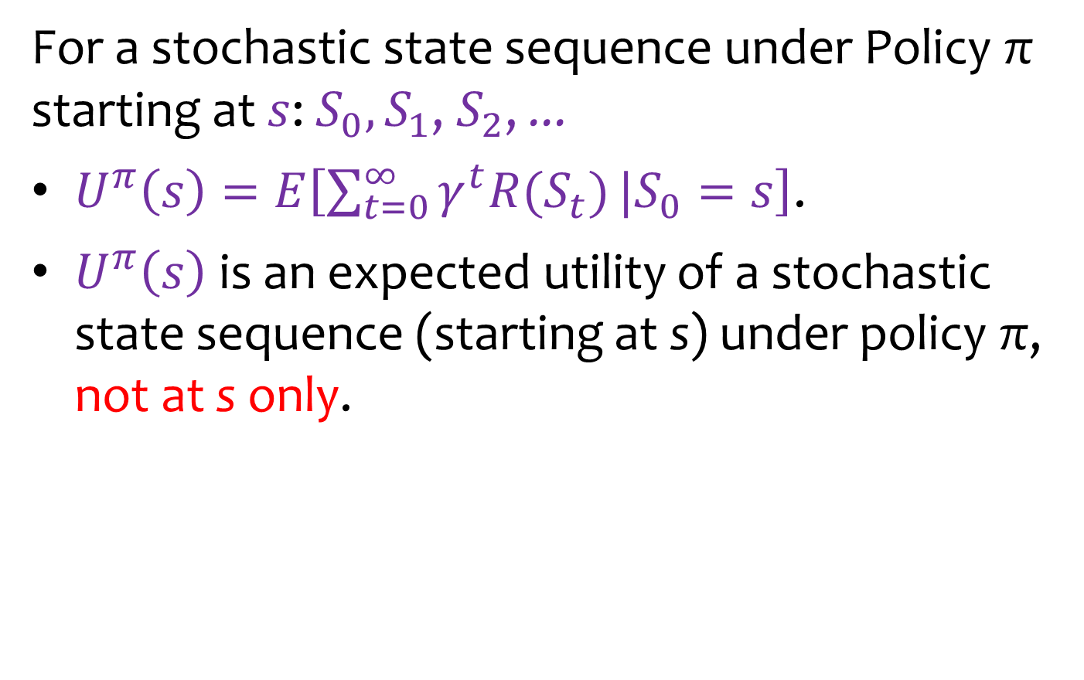
Expected Utility
For a stochastic state sequence under Policy π starting at $s$: $S_{0}, S_{1}$, $S_{2}$, ...
$U^{π}\left(s\right)=E\left[\sum_{t=0}^{∞}{γ^{t}{R(S}_{t})}|S_{0}=s\right]$.
$U^{π}\left(s\right)$ is an expected utility of a stochastic state sequence (starting at s) under policy π, not at s only.

Slide 29

Example
$$γ=0.9$$
Reward
$U^{π}\left(a1\right)= ?$
-1 | -1 | -1 | +100
-1 |  | -1 | -100
-1 | -1 | -1 | -1
c
b
a
1
2
3
4
→ | → | → | +100
↑ |  | ← | -100
↑ | ← | ← | ↓
c
b
a
1
2
3
4
Policy

Slide 30
Methodology
Utilities are combined with probabilities in the general theory of rational decisions called decision theory:
Probability Theory
Decision Theory
Utility Theory
Notes:
Utility theory = preference for a sequence.

Slide 31
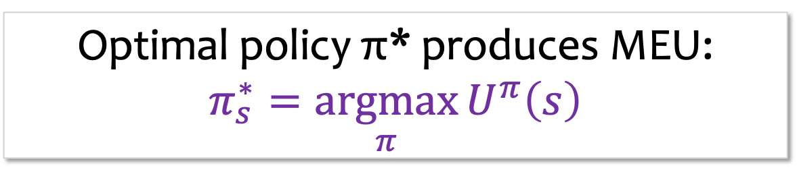
Principle of Maximum Expected Utility (MEU)
An agent is rational if and only if it chooses the action that yields the highest expected utility, averaged over all the possible outcomes of the action.
Optimal policy π* produces MEU:
$$π_{s}^{∗}=\underset{π}{argmax}{U^{π}\left(s\right)}$$
Fundamental idea of decision theory

Slide 32
Conventional Planning
-1 | -1 | -1 | +100
-1 |  | -1 | -100
-1 | -1 | -1 | -1
Search Tree
c
a1
b
N
S
W
E
a
1
2
3
4
a2
b1
a1
a1
a2
Build a search tree
Trace all possible sequences for each policy
Calculate the expected utility for each policy
Identify the optimal policy
Notes:
Problem with Conventional Planning: search trees can grow exponentially if every new node produces the same number of new nodes as its parent → includes loop issues where new nodes are simply the result of loops/repeating previous nodes.
How to mitigate this through some estimation?

Slide 33
Issues with Conventional Planning
-1 | -1 | -1 | +100
-1 |  | -1 | -100
-1 | -1 | -1 | -1
Search Tree
c
a1
4 action choices
b
N
S
W
E
Up to 3 different outcomes per action choice
a
1
2
3
4
a2
b1
a1
a1
a2
Branching factor is too large
Many states visited too often.
Tree too deep (maybe infinite loop).

Slide 34
Example
-1 | -1 | -1 | +100
-1 |  | -1 | -100
-1 | -1 | -1 | -1
c
b
a
1
2
3
4
How many states can we reach from b3 with all potential actions?
4 states:
←: b3, c3, a3
↑: b3, b4, c3
→: c3, b4, a3
↓: b3, b4, a3

Slide 35
Quiz
-1 | -1 | -1 | +100
-1 |  | -1 | -100
-1 | -1 | -1 | -1
a1
→
c
0.8
0.1
0.1
b
↑
a2
b1
a1
→
→
↑
→
→
0.8
0.2
0.8
0.2
0.8
0.1
a
0.1
a3
a2
c1
b1
a2
b1
a1
1
2
3
4
How many states can we reach from a1 after two sequential actions under the given policy and with what probabilities?
a3: 0.8*0.8=0.64
a2: 0.8*0.2+0.1*0.8=0.24
c1: 0.1*0.8 = 0.08
b1: 0.1*0.2+0.1*0.1=0.03
a1: 0.1*0.1=0.01

Slide 36
Outline
Conditional Plan
Markov Decision Process (MDP)
Value Iteration
Notes:
Beauty of iteration: we can simply use prior (using Markov Assumption and transitional probability convergence) and iterate many times to converge on a good estimation for the best policy → you can save memory (in exchange for time).

Slide 37
Quiz
0 | 0 | 0 | +100
0 |  | 0 | -100
0 | 0 | 0 | 0
c
N
b
W
E
a
S
1
2
3
4
What is the optimal action at the grid to reach +100?
c1 | a1 | a4 | b3
E
N
S
W
Notes:
In above example, 10% drift left, 10% drift right, 80% we move forward in desired direction.
For C1, the reason answer is not N is because although we have chance of drifting south to b1 if we move E, there is no penalty for going south to b1; we only need to consider b3 and a4 in terms of possibly getting negative reward; so from any other location, choose the direction that highest chance of moving closest to goal.

Slide 38
Optimal Actions for All Grids
→ | → | → | +100
↑ |  | ← | -100
↑ | ← | ← | ↓
c
b
a
1
2
3
4

Slide 39
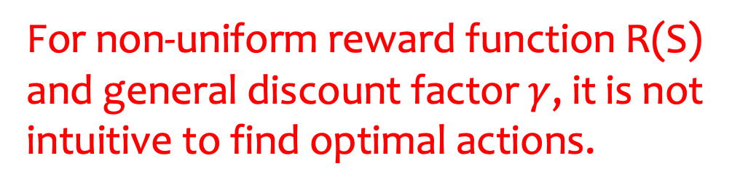
Optimal Actions for All Grids
-3 | -1 | -1 | +100
-2 |  | -3 | -100
0 | -2 | -4 | -1
c
b
a
1
2
3
4
For non-uniform reward function R(S) and general discount factor $γ$, it is not intuitive to find optimal actions.

Slide 40

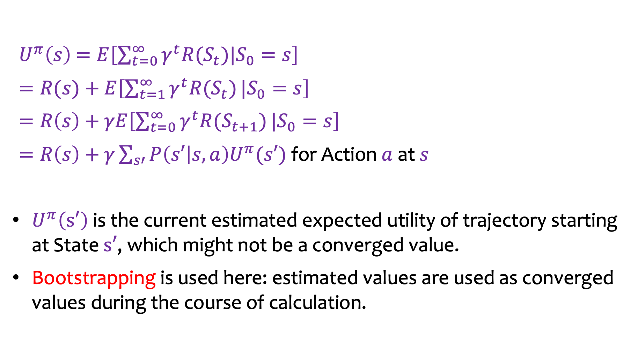




Utility Calculation
-3 | -1 | -1 | +100
-2 |  | -3 | -100
0 | -2 | -4 | -1
$U^{π}\left(s\right)$ $=E\left[\sum_{t=0}^{∞}{γ^{t}{R(S}_{t})|S_{0}=s}\right]$
$=R(s)+E\left[\sum_{t=1}^{∞}{γ^{t}{R(S}_{t})}|S_{0}=s\right]$
$=R\left(s\right)+γE\left[\sum_{t=0}^{∞}{γ^{t}{R(S}_{t+1})}|S_{0}=s\right]$
$=R\left(s\right)+γ\sum_{s′}{P\left(s′ | s,a\right)U^{π}(s′)}$ for Action $a$ at $s$
$U^{π}\left(s′\right)$ is the current estimated expected utility of trajectory starting at State $s′$, which might not be a converged value.
Bootstrapping is used here: estimated values are used as converged values during the course of calculation.
$$s′$$
$$a$$
↑
$$s$$
$$s′$$
$$s′$$
Notes:
Using bootstrapping, you essentially calculate utility of a given state during a given iteration based only on neighboring states of the given state you are calculating.
Then, over many iterations, the values of calculations for each of the states will propagate to all other location and affect their value until they converge.
At the observing state (current state being calculated) the reward is itself when considering the state and its neighbors for calculating its utility.

Slide 41

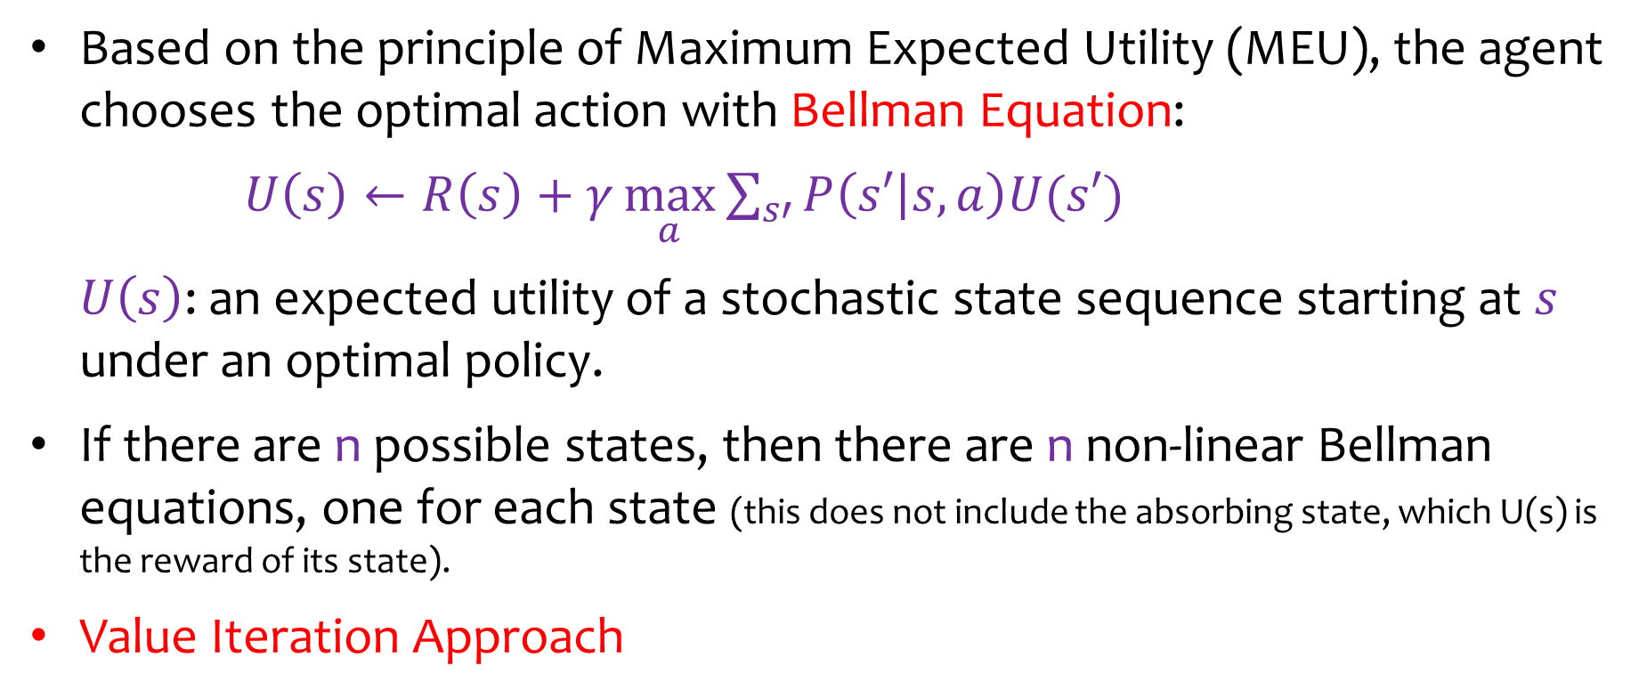


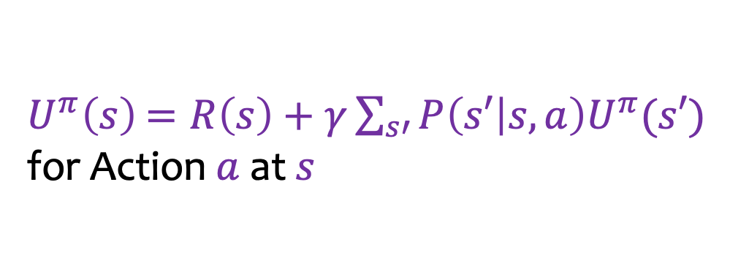

Bellman Equation
-3 | -1 | -1 | +100
-2 |  | -3 | -100
0 | -2 | -4 | -1
$U^{π}\left(s\right)$ $=R\left(s\right)+γ\sum_{s′}{P\left(s′ | s,a\right)U^{π}(s′)}$
for Action $a$ at $s$
$$s′$$
$$a$$
↑
$$s$$
$$s′$$
$$s′$$
Based on the principle of Maximum Expected Utility (MEU), the agent chooses the optimal action with Bellman Equation:
$U\left(s\right)←R\left(s\right)+γ\underset{a}{\text{max}}{\sum_{s′}{P\left(s′ | s,a\right)U(s′)}}$
$U\left(s\right)$: an expected utility of a stochastic state sequence starting at $s$ under an optimal policy.
If there are n possible states, then there are n non-linear Bellman equations, one for each state (this does not include the absorbing state, which U(s) is the reward of its state).
Value Iteration Approach
Notes:
U(s)← Refers to updated value of utility calculated at a state s.
The bellman equation is nonlinear; so we can use Value Iteration Approach to implement Bellman Update Equation at each state (version of Bellman Equation that creates propagation through iteration until all states converge).

Slide 42
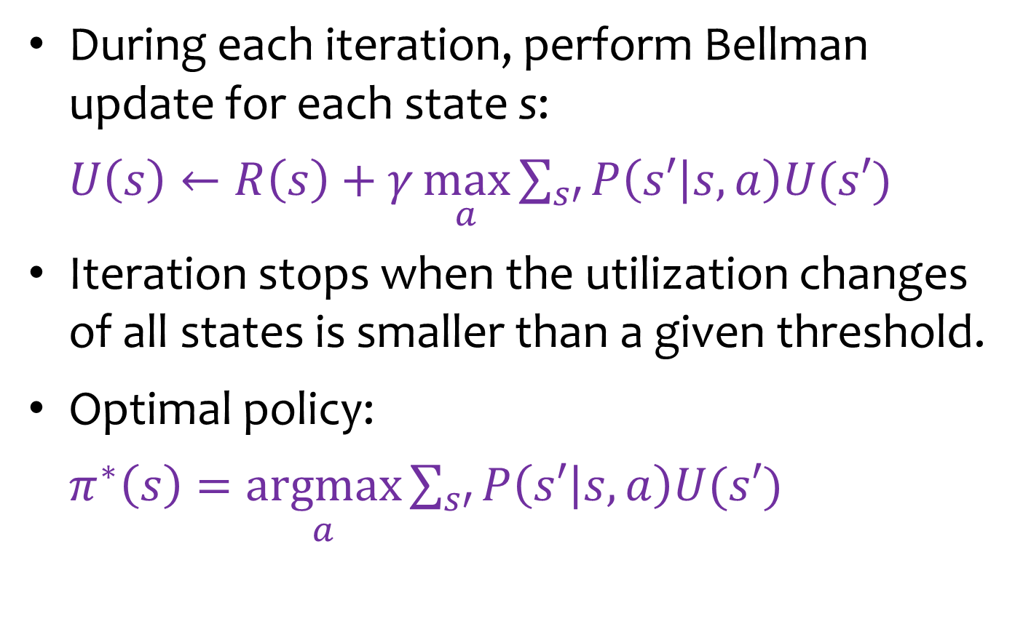
Value Iteration
During each iteration, perform Bellman update for each state s:
$U\left(s\right)←R\left(s\right)+γ\underset{a}{\text{max}}{\sum_{s′}{P\left(s′ | s,a\right)U(s′)}}$
Iteration stops when the utilization changes of all states is smaller than a given threshold.
Optimal policy:
$π^{∗}\left(s\right)=\underset{a}{\text{argmax}}{\sum_{s′}{P\left(s′ | s,a\right)U(s′)}}$

Slide 43



Example
$$γ=1$$
Reward
s = c3, and a =
←: -3+0+0+0=-3
↑: -3+0.1*100+0+0 = 7
→: -3+0.8*100+0+0 = 77
↓: -3+0.1*100+0+0 = 7
$U\left(c3\right)=77$
-3 | -3 | -3 | +100
-3 |  | -3 | -100
-3 | -3 | -3 | -3
c
b
a
1
2
3
4
0 | 0 | 0 | +100
0 |  | 0 | -100
0 | 0 | 0 | 0
c
$$77$$
b
a
1
2
3
4
Utility
Notes:
If possible, we want to start as close to goal state as possible so values will propagate faster/more effectively and we can converge in less iterations.
Notice above when calculating utility for a state: first you add the reward value at the current state, then add the weighted reward for possible next states.
So above, max (MEU) is 77, so at least at THIS moment, best action at c3 is to move right.

Slide 44


Example
$$γ=1$$
Reward
s = b3, and a =
←: -3+0.1*77+0+0 = 4.7
↑: -3+0.8*77-0.1*100+0 = 48.6
→: -3-0.8*100+0.1*77+0 = -75.3
↓: -3-0.1*100+0+0 = -13
$U\left(b3\right)=48.6$
-3 | -3 | -3 | +100
-3 |  | -3 | -100
-3 | -3 | -3 | -3
c
b
a
1
2
3
4
0 | 0 | 77 | +100
0 |  | 0 | -100
0 | 0 | 0 | 0
c
b
$$48.6$$
a
1
2
3
4
Utility

Slide 45


Example
$$γ=1$$
Reward
s = a3, and a =
←: -3+0.1*48.6+0+0 = 1.86
↑: -3+0.8*48.6+0+0 = 35.88
→: -3+0.1*48.6+0+0 = 1.86
↓: -3+0+0+0 = -3
$U\left(a3\right)=\text{35.}\text{9}$
-3 | -3 | -3 | +100
-3 |  | -3 | -100
-3 | -3 | -3 | -3
c
b
a
1
2
3
4
0 | 0 | 77 | +100
0 |  | 48.6 | -100
0 | 0 | 0 | 0
c
b
a
$$35.9$$
1
2
3
4
Utility

Slide 46


Example
$$γ=1$$
Reward
s = c2, and a =
←: -3+0+0+0 = -3
↑: -3+0.1*77+0+0 = 4.7
→: -3+0.8*77+0+0 = 58.6
↓: -3+0.1*77+0+0 = 4.7
$U\left(c2\right)=$ $\text{58.6}$
-3 | -3 | -3 | +100
-3 |  | -3 | -100
-3 | -3 | -3 | -3
c
b
a
1
2
3
4
0 | 0 | 77 | +100
0 |  | 48.6 | -100
0 | 0 | 35.9 | 0
c
$$58.6$$
b
a
1
2
3
4
Utility
Notes:
OBJECTIVE: FIND OUT BEST POTENTIAL ACTION AT EACH STATE
(need to do this because best path is not deterministic because of large state space due to probability of errors).
(also, we do not consider the final convergence of all utility values at each state to form a “path” per say, but rather just the best action AT EACH STATE since at every state the next state is stochastic).
Nonetheless, you could use converged utility values from many bellman updates (value iterations) to estimate a possible “best path”.
NOTE: no matter what state you start with in doing iterations, you will always converge to the same values for all states.

Slide 47

Quiz
$$γ=1$$
Reward
s = a3, and a =
←: ?
↑: ?
→: ?
↓: ?
$U\left(a3\right)=$ $\text{?}$
-3 | -3 | -3 | +100
-3 |  | -3 | -100
-3 | -3 | -3 | -3
c
b
a
1
2
3
4
79.0 | 89.7 | 93.1 | +100
57.2 |  | 68.1 | -100
20.9 | 42.5 | 57.9 | 36.3
c
b
a
1
2
3
4
Utility

Slide 48
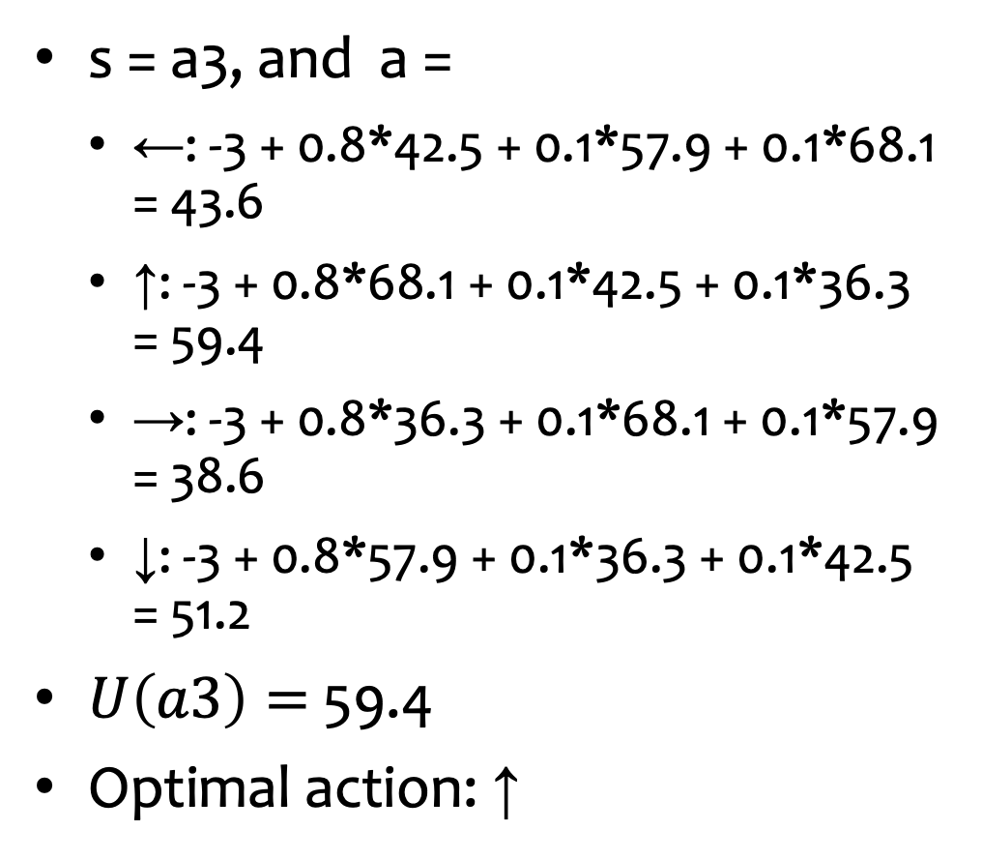
Solution
$$γ=1$$
Reward
s = a3, and a =
←: -3 + 0.8*42.5 + 0.1*57.9 + 0.1*68.1 = 43.6
↑: -3 + 0.8*68.1 + 0.1*42.5 + 0.1*36.3 = 59.4
→: -3 + 0.8*36.3 + 0.1*68.1 + 0.1*57.9 = 38.6
↓: -3 + 0.8*57.9 + 0.1*36.3 + 0.1*42.5 = 51.2
$U\left(a3\right)=$ $\text{59.4}$
Optimal action: ↑
-3 | -3 | -3 | +100
-3 |  | -3 | -100
-3 | -3 | -3 | -3
c
b
a
1
2
3
4
79.0 | 89.7 | 93.1 | +100
57.2 |  | 68.1 | -100
20.9 | 42.5 | 57.9 | 36.3
c
b
a
1
2
3
4
Utility

Slide 49
Converged Values
$$γ=1$$
Reward
Utilities converge after many iterations.
-3 | -3 | -3 | +100
-3 |  | -3 | -100
-3 | -3 | -3 | -3
c
b
a
1
2
3
4
85.2 | 89.4 | 93.2 | +100
81.4 |  | 68.4 | -100
77.2 | 73.5 | 69.6 | 47.4
c
b
a
1
2
3
4
Utility

Slide 50
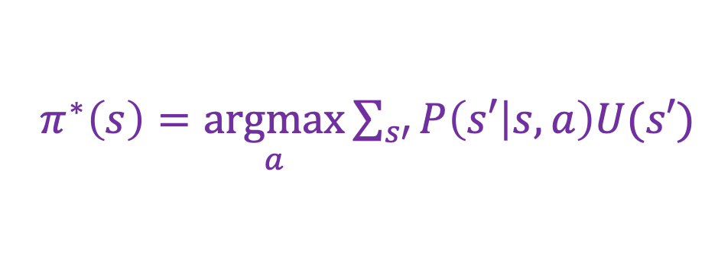
Example: Optimal Policy
$$γ=1$$
Reward
$π^{∗}\left(s\right)=\underset{a}{\text{argmax}}{\sum_{s′}{P\left(s′ | s,a\right)U(s′)}}$
-3 | -3 | -3 | +100
-3 |  | -3 | -100
-3 | -3 | -3 | -3
c
b
→ | → | → | +100
↑ |  | ↑ | -100
↑ | ← | ← | ←
c
a
b
1
2
3
4
85 | 89 | 93 | +100
81 |  | 68 | -100
77 | 73 | 70 | 47
a
c
1
2
3
4
b
Optimal Policy
a
1
2
3
4
Utility

Slide 51
Example
Rewards at the other squares are 0.
$$γ=1$$
Reward
0 | 0 | 0 | +100
0 |  | 0 | -100
0 | 0 | 0 | 0
c
b
→ | → | → | +100
↑ |  | ← | -100
↑ | ← | ← | ↓
c
a
b
1
2
3
4
100 | 100 | 100 | +100
100 |  | 100 | -100
100 | 100 | 100 | 100
a
c
1
2
3
4
b
Optimal Policy
a
1
2
3
4
Utility

Slide 52
Example
Rewards at the other squares are -200.
$$γ=1$$
Reward
-200 | -200 | -200 | +100
-200 |  | -200 | -100
-200 | -200 | -200 | -200
c
b
→ | → | → | +100
↑ |  | → | -100
→ | → | → | ↑
c
a
b
1
2
3
4
-704 | -423 | -173 | +100
-954 |  | -357 | -100
-1082 | -847 | -597 | -377
a
c
1
2
3
4
b
Optimal Policy
a
1
2
3
4
Utility

Slide 53
Outline
Conditional Plan
Markov Decision Process (MDP)
Value Iteration (utility-centered/oriented)
Policy Iteration (policy-centered/oriented)

Slide 54
Value Iteration
We initialize the utility value at each state.
We iterate:
Converging utility values;
Converging optimal actions;

Slide 55
Policy Iteration
We initialize the action at each state, i.e., a policy for all states.
We iterate:
Obtaining the utility at each state;
Improving the action at each state (i.e., the policy for all states) based on the newly obtained utility;

Slide 56
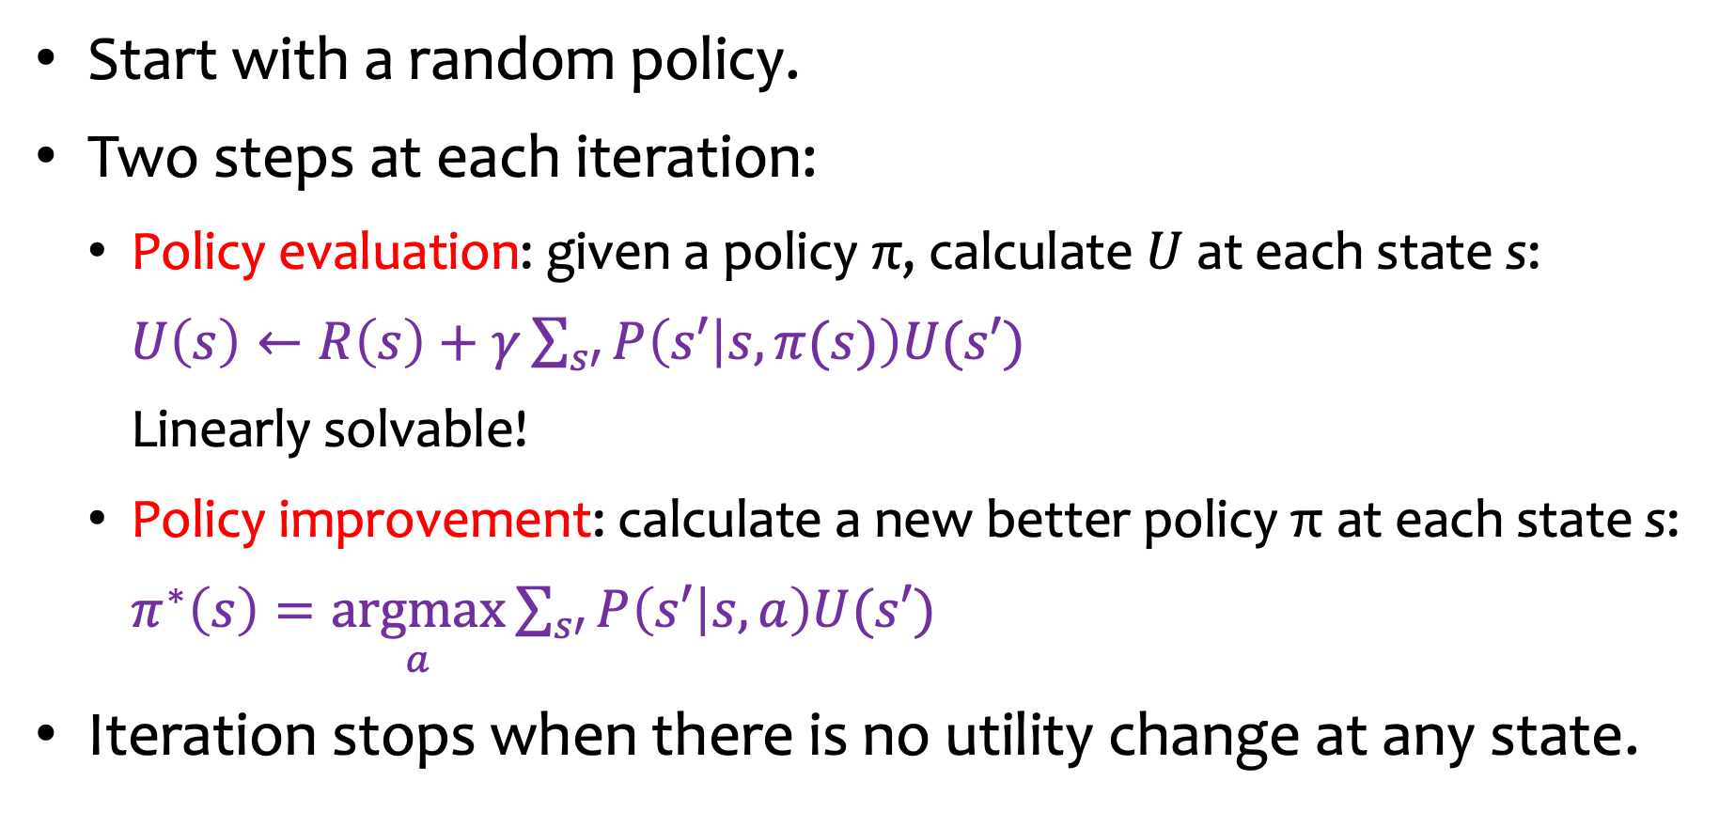
Policy Iteration in Details
Start with a random policy.
Two steps at each iteration:
Policy evaluation: given a policy π, calculate $U$ at each state s:
$U\left(s\right)←R\left(s\right)+γ\sum_{s′}{P\left(s′ | s,π(s)\right)U(s′)}$
Linearly solvable!
Policy improvement: calculate a new better policy π at each state s:
$π^{∗}\left(s\right)=\underset{a}{\text{arg}\text{max}}{\sum_{s′}{P\left(s′ | s,a\right)U(s′)}}$
Iteration stops when there is no utility change at any state.
Notes:
If you know the policy (because we set it), then you know the action at each state.

Slide 57
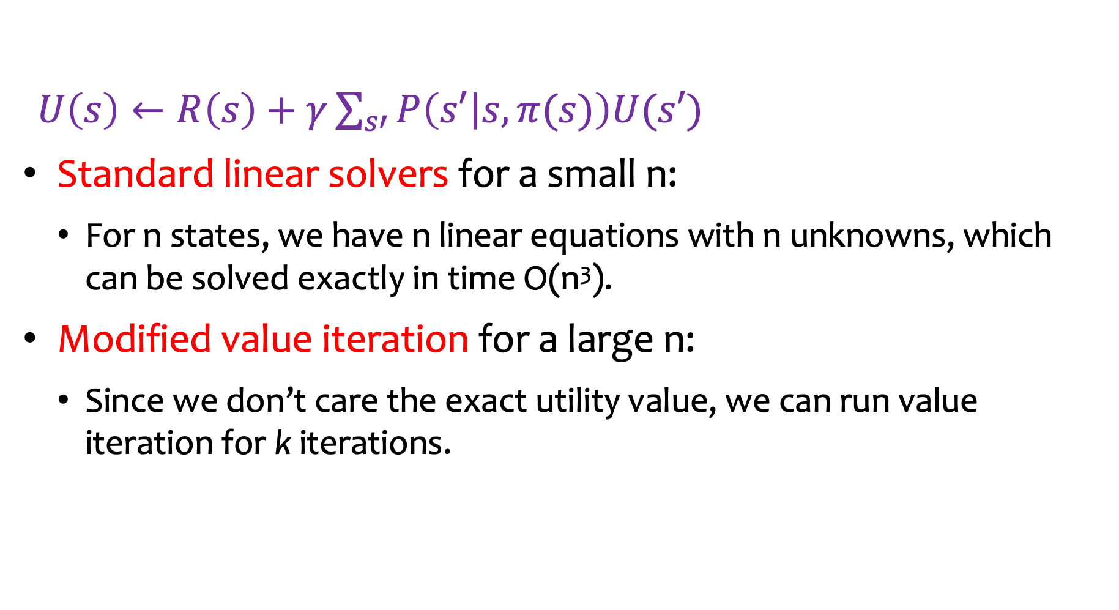
Two Approaches for Policy Evaluation
$U\left(s\right)←R\left(s\right)+γ\sum_{s′}{P\left(s′ | s,π(s)\right)U(s′)}$
Standard linear solvers for a small n:
For n states, we have n linear equations with n unknowns, which can be solved exactly in time O(n³).
Modified value iteration for a large n:
Since we don’t care the exact utility value, we can run value iteration for k iterations.
Notes:
n → refers to number of states.
Note the difference between the value iteration approach: the current (optimized) policy is not used; you start from scratch at each iteration do not consider current best policy; with policy evaluation, you start with random chosen policy (determined action at each state), then you tune based on calculated utility what the best policy should be updated as, AND that newly updated policy (determined best action for all states) will be used in the next iteration.

Slide 58
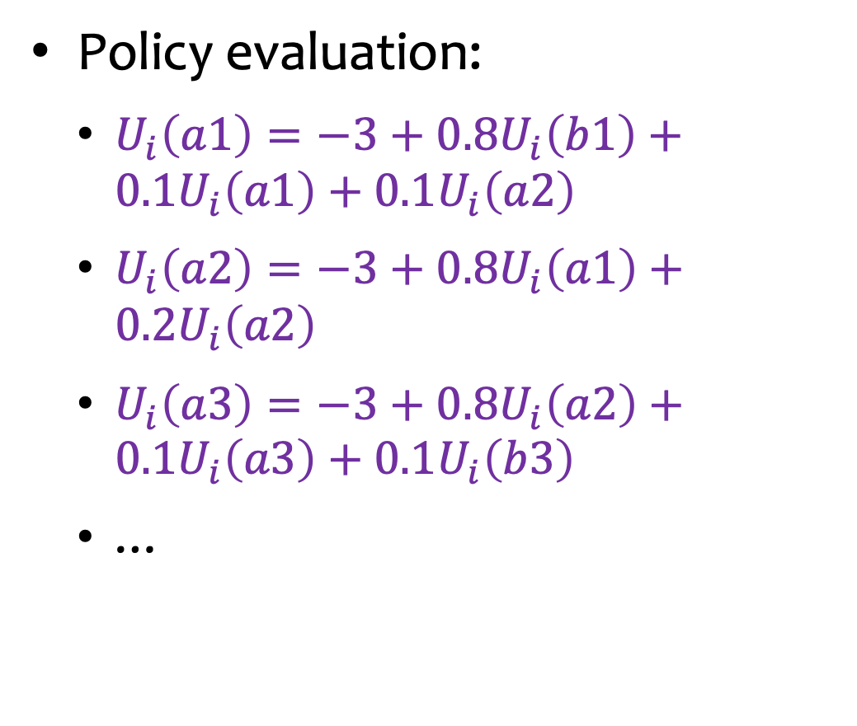
Example
$$γ=1$$
Reward
Policy evaluation:
$U_{i}\left(a1\right)=−3+0.8U_{i}\left(b1\right)+0.1U_{i}\left(a1\right)+0.1U_{i}\left(a2\right)$
$U_{i}\left(a2\right)=−3+0.8U_{i}\left(a1\right)+0.2U_{i}\left(a2\right)$
$U_{i}\left(a3\right)=−3+0.8U_{i}\left(a2\right)+0.1U_{i}\left(a3\right)+0.1U_{i}\left(b3\right)$
…
-3 | -3 | -3 | +100
-3 |  | -3 | -100
-3 | -3 | -3 | -3
c
b
a
1
2
3
4
→ | → | → | +100
↑ |  | ↑ | -100
↑ | ← | ← | ←
c
b
a
1
2
3
4
Policy

Slide 59
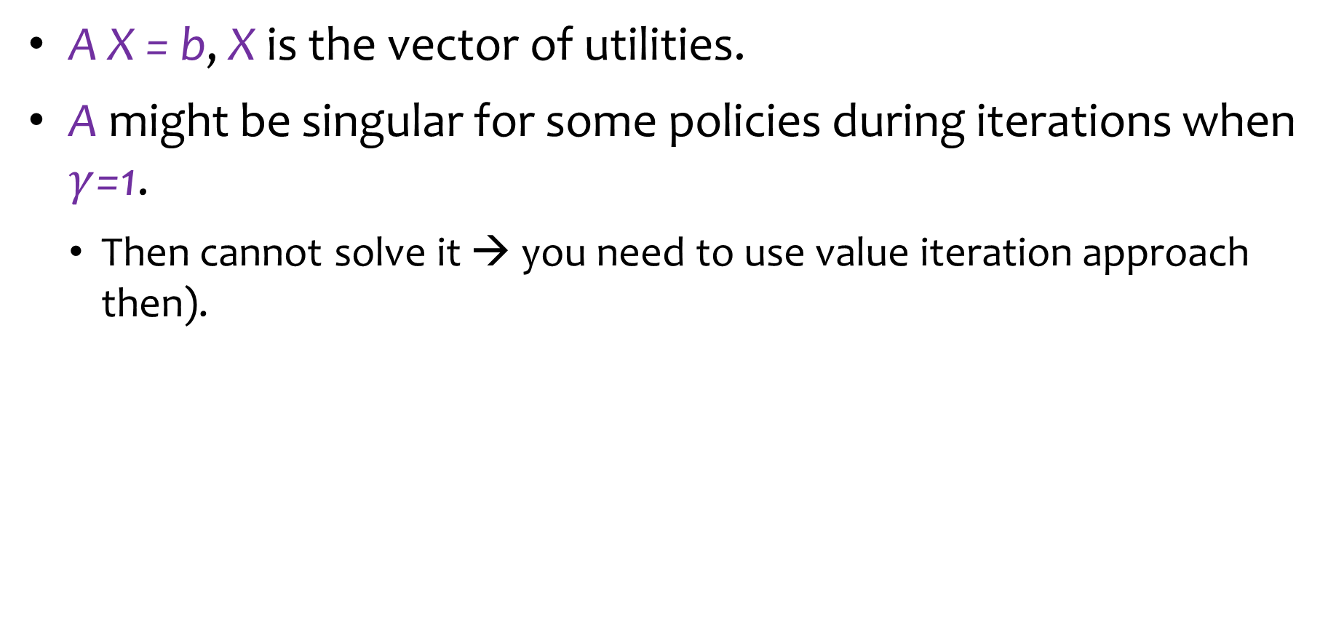
Issue with Linear Solvers
A X = b, X is the vector of utilities.
A might be singular for some policies during iterations when $γ$=1.
Then cannot solve it → you need to use value iteration approach then).

Slide 60
Outline
Conditional Plan
Markov Decision Process (MDP)
Value Iteration
Policy Iteration
Partially Observable MDP (POMDP)

Slide 61
Partially Observable
 |  |  | +100
 |  |  | -100
c
b
a
1
2
3
4
The agent doesn’t know for sure which state it is in except for the two terminal states.

Slide 62
Belief State
 |  |  | +100
 |  |  | -100
1/9 | 1/9 | 1/9 | 0
1/9 |  | 1/9 | 0
1/9 | 1/9 | 1/9 | 1/9
c
b
a
1
2
3
4
Initially, the agent is in one of the nine nonterminal states.
The belief state is with distribution shown in the above table.

Slide 63
Belief State
 |  |  | +100
 |  |  | -100
1/6 | 1/6 | 0 | 0
1/6 |  | 0 | 0
1/6 | 1/6 | 0 | 1/6
c
b
a
1
2
3
4
A noisy sensor can only measure the number of adjacent walls (1 for a3, b3, c3; 2 for the rest). Assume no error in the sensor or movement for this example.
If it senses two walls, the belief state distribution will change based on filtering.

Slide 64
Belief State: Updated
1/6 | 1/6 | 0 | 0
1/6 |  | 0 | 0
1/6 | 1/6 | 0 | 1/6
0 | 0 | 0 | 0
0 |  | 0 | 0
0 | 0 | 1 | 0
c
b
a
1
2
3
4
Suppose the agent moves Left and its sensor reports 1 adjacent wall.
Then the agent is now in a3 if both the motion and the sensor are perfect (assumption in this model/example).

Slide 65
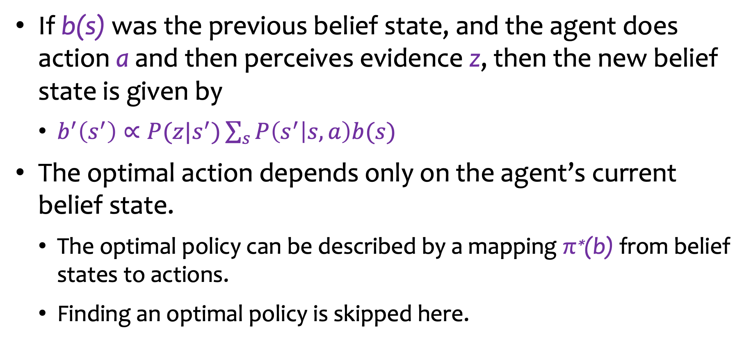
POMDP
If b(s) was the previous belief state, and the agent does action a and then perceives evidence z, then the new belief state is given by
$b^{′}\left(s^{′}\right)∝P(z|s^{′})\sum_{s}{P\left(s^{′} | s,a\right)b(s)}$
The optimal action depends only on the agent’s current belief state.
The optimal policy can be described by a mapping π∗(b) from belief states to actions.
Finding an optimal policy is skipped here.
Notes:
So we can combine the robot localization problem with the decision and planning problem.
If we didn’t have even the map of the environment, we would have a SLAM problem (simultaneous localization and mapping problem)

Slide 66
MDP/POMDP Examples
Harvesting: how much members of a population have to be left for breeding.
Agriculture: how much to plant based on weather and soil state.
Water resources: keep the correct water level at reservoirs.
Inspection, maintenance and repair: when to replace/inspect based on age, condition, etc.
Purchase and production: how much to produce based on demand.
Queues: reduce waiting time.
Finance: deciding how much to invest in stock.
Robotics: exploration for navigation.
Notes:
Humans are able to generalize really well; so although computers are more powerful than human brain computationally in specific calculations, it is still very far behind our ability to generalize.
In our next lecture, we will discuss how to approach MDPs when we do not have the transition model (we need to figure out/estimate the transition model → this is machine learning) → we will collect data and figure out the model at the same time we calculate best action at each state.

